Slide 1
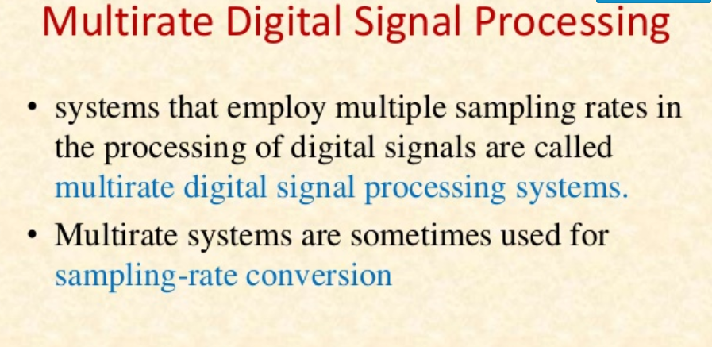
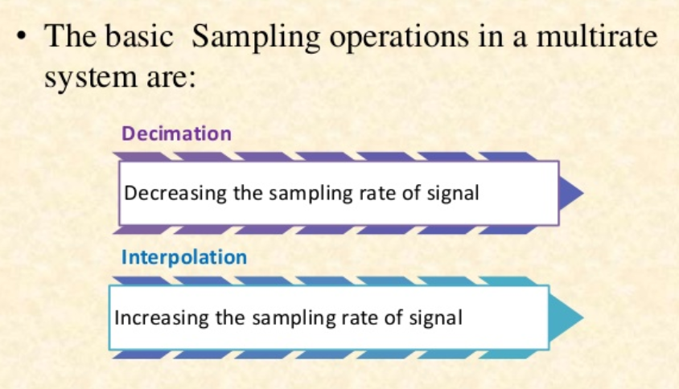
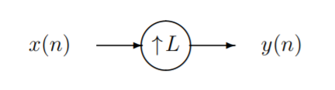
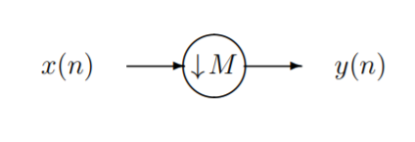

Slide 2
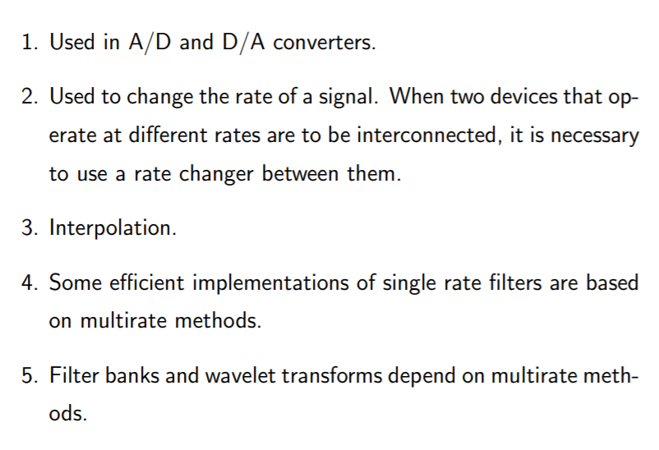
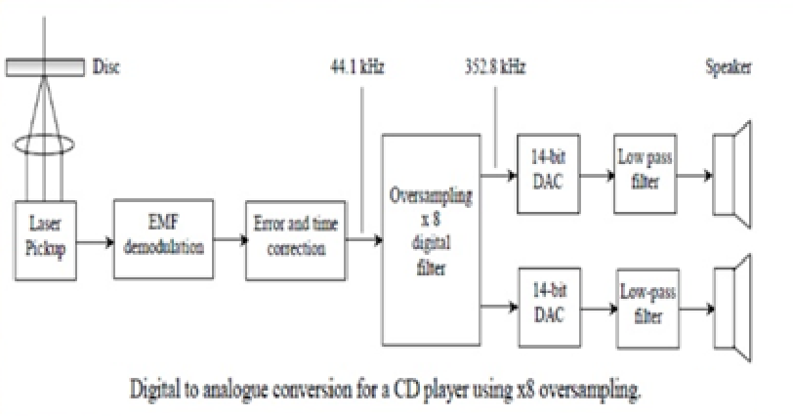
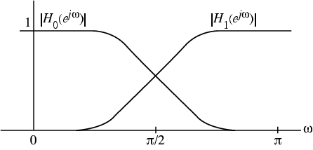
Applications

Slide 3
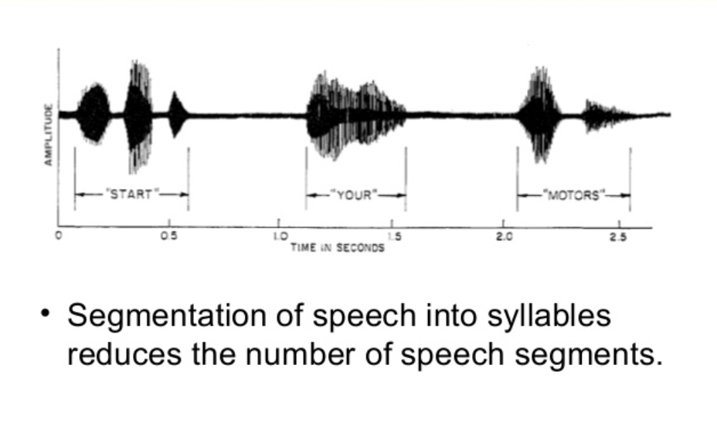
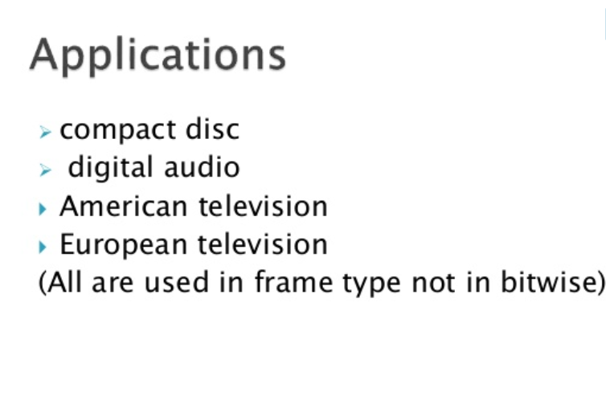
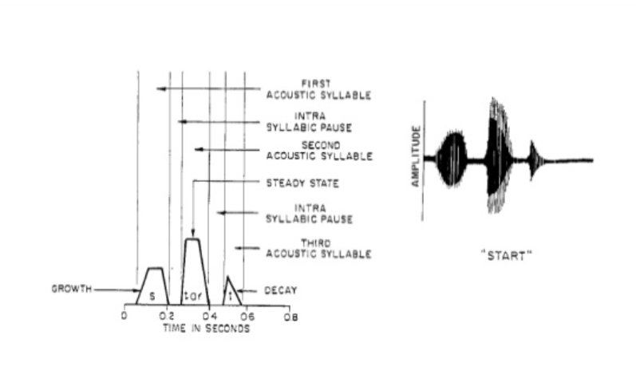
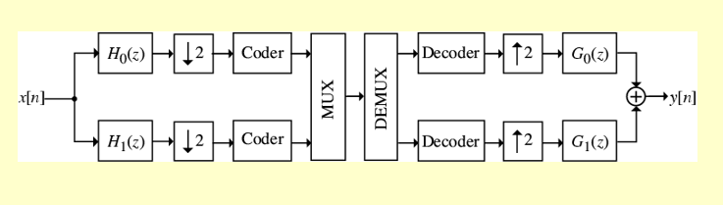

Slide 4
Standards are different in Europe and US.
Same signal with different technologies uses different sampling rate so we use multirate signal processing techniques.
Mixing signals have different standards
CD player:44.1KHZ
Digital audio tape :48KHZ
Digital broadcasting: 32KHZ

Slide 5
Audio signal is sampled at Fx = 22KHZ (all the frequency +_11 KHZ)
5. Signal is resampled Fy = Fx/4 = 5.5KHZ; with proper prefiltering . The spectrum is limited (+-2.75KHZ)
If we listen : The loss of high frequency components due to lower sampling rate but no distortion
6. Signal is resampled at lower sampling frequency just by eliminating three out of four samples , but without appropriate filtering. There are artifacts in frequency spectrum markes as aliases,

Slide 6
Multirate signal processing:
Decimation
Interpolation
Sampling rate conversion by a rational factor

Slide 7
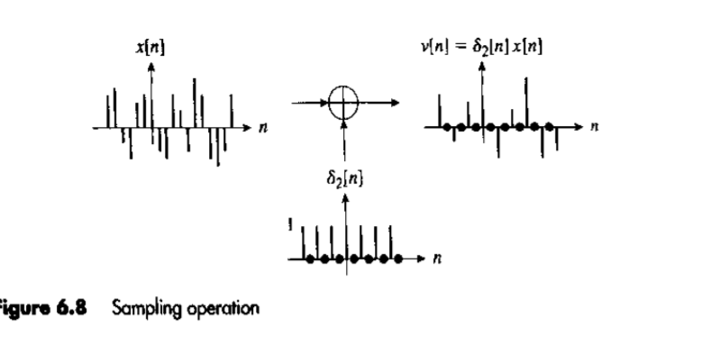

Slide 8
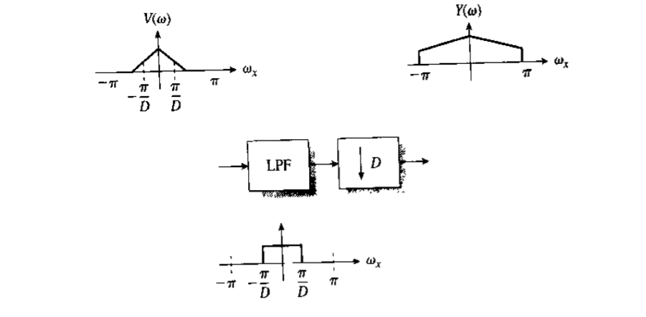

Slide 9
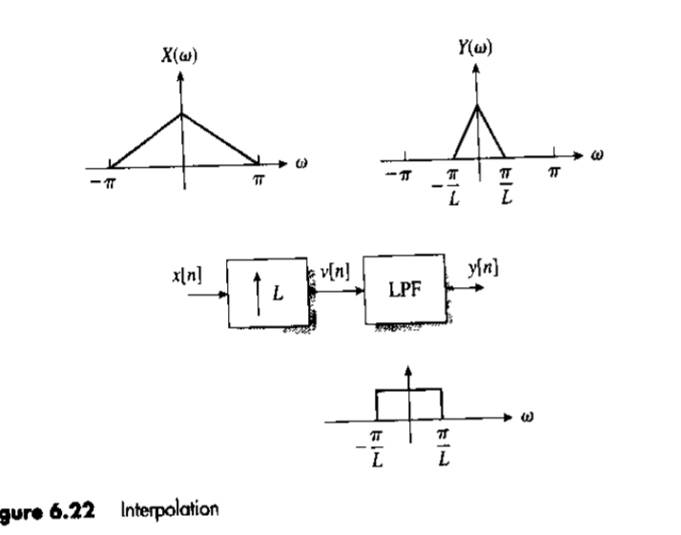

Slide 10
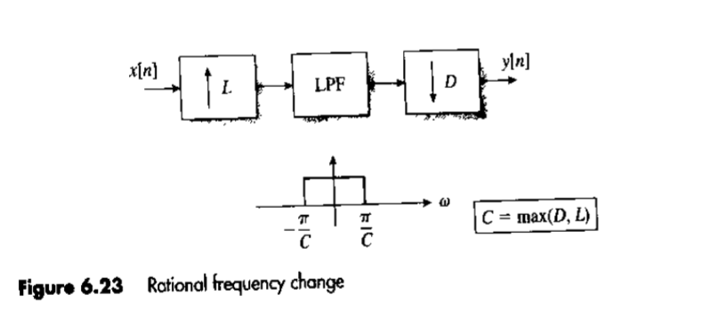

Slide 11
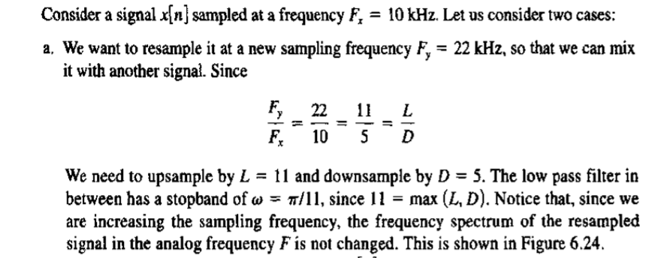
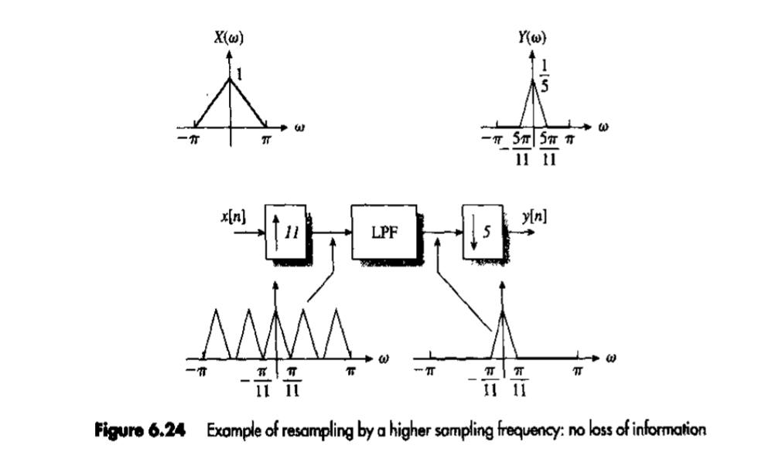

Slide 12
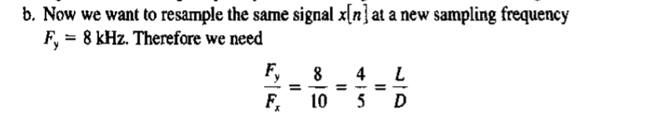
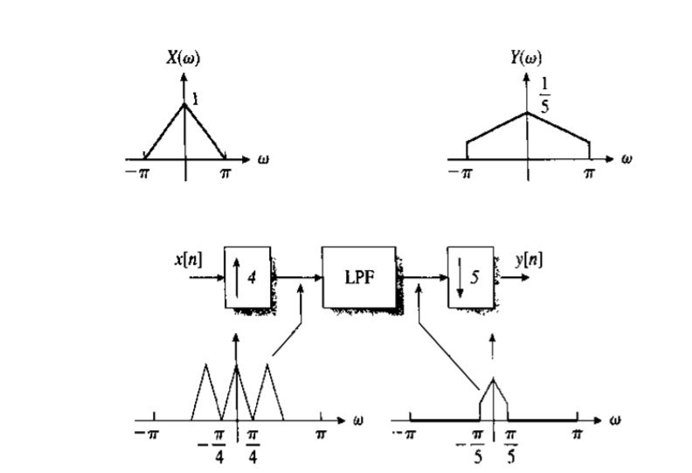

Slide 13
